Slide 1


TMG Meeting NTUA Report 24/2/2020
K. Kousouris, G. Tsipolitis, G.Bakas, I. Papakrivopoulos

Slide 2
Status Report
Purpose:
Show the inconsistencies between the different Nominal and Mtt files
2016, 2017, 2018
Parton Level quantities

Slide 3
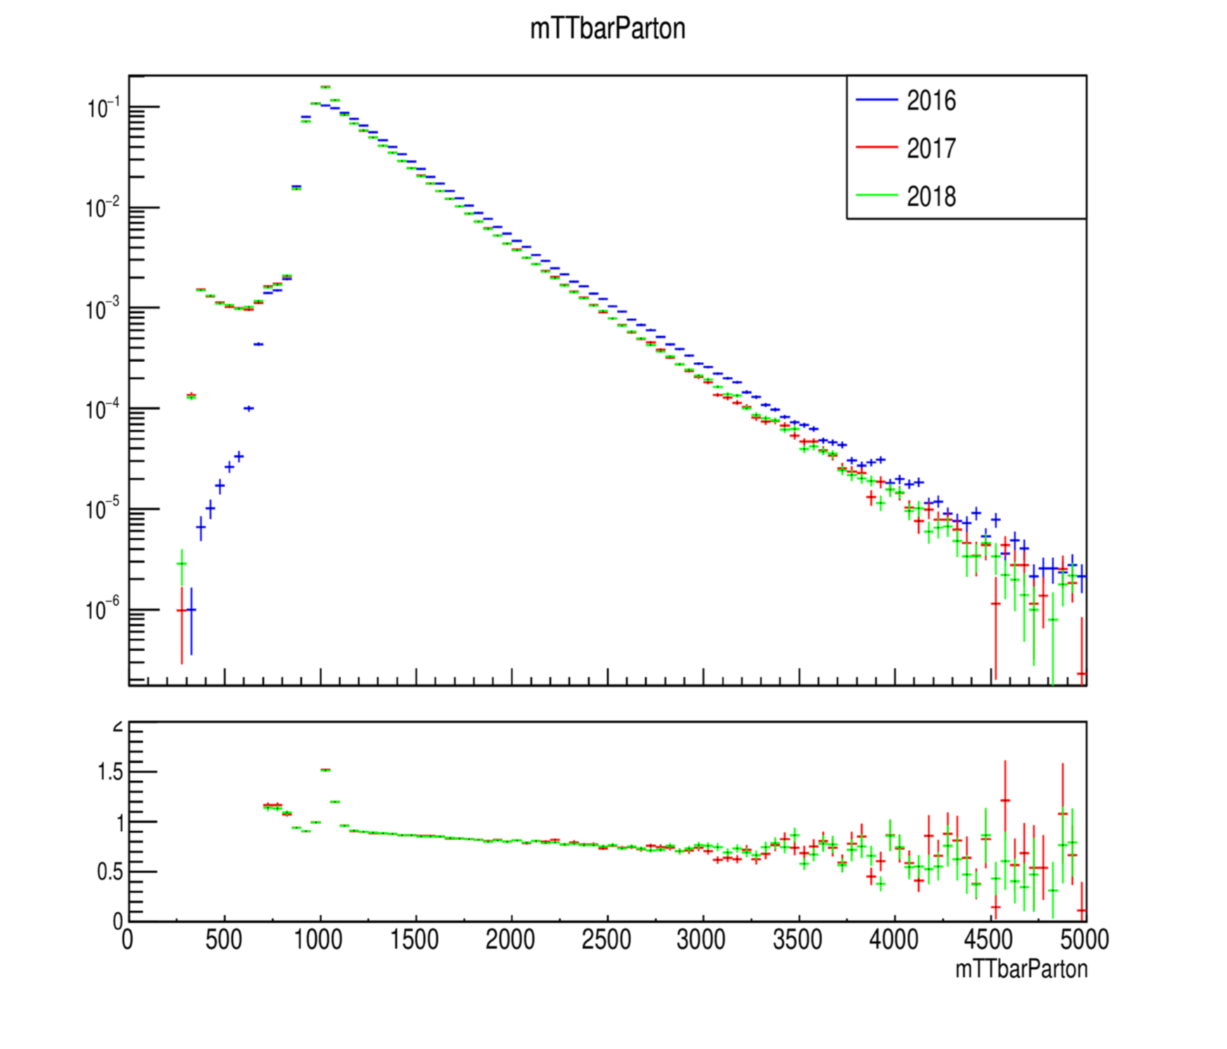
MC Closure tests ’16, ‘17 and ’18 (shape) for mtt files

Slide 4
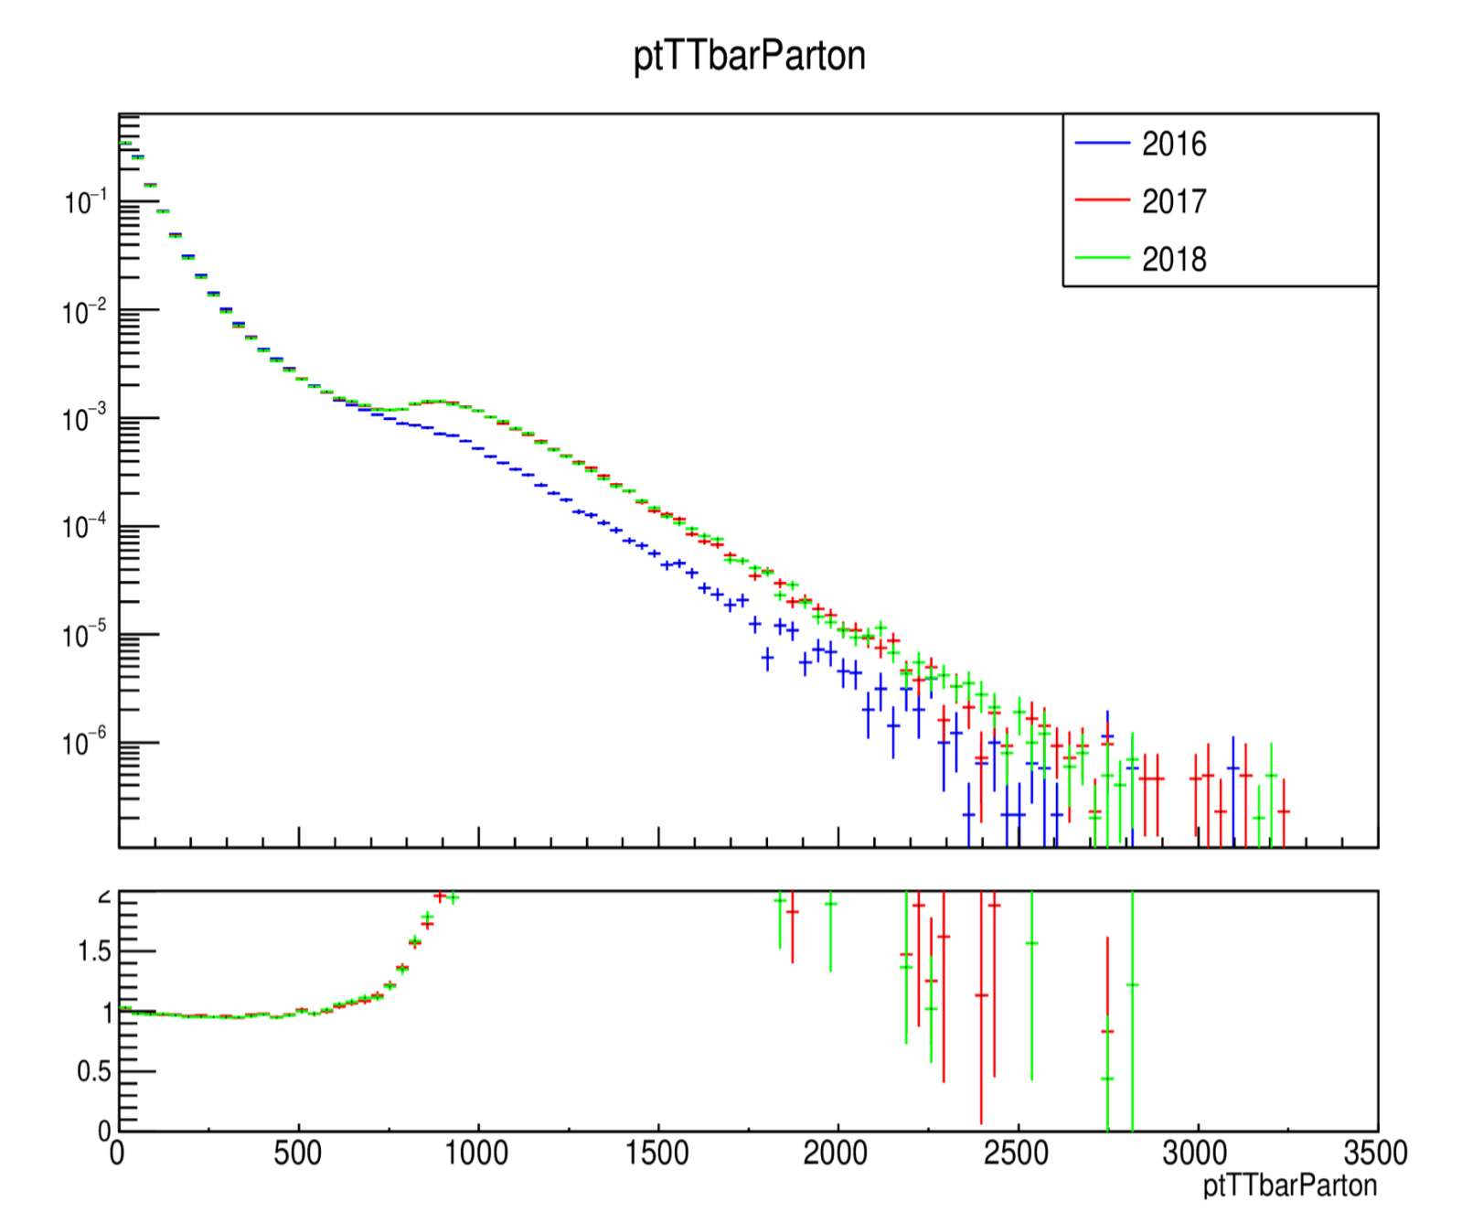
MC Closure tests ’16, ‘17 and ’18 (shape) for mtt files

Slide 5
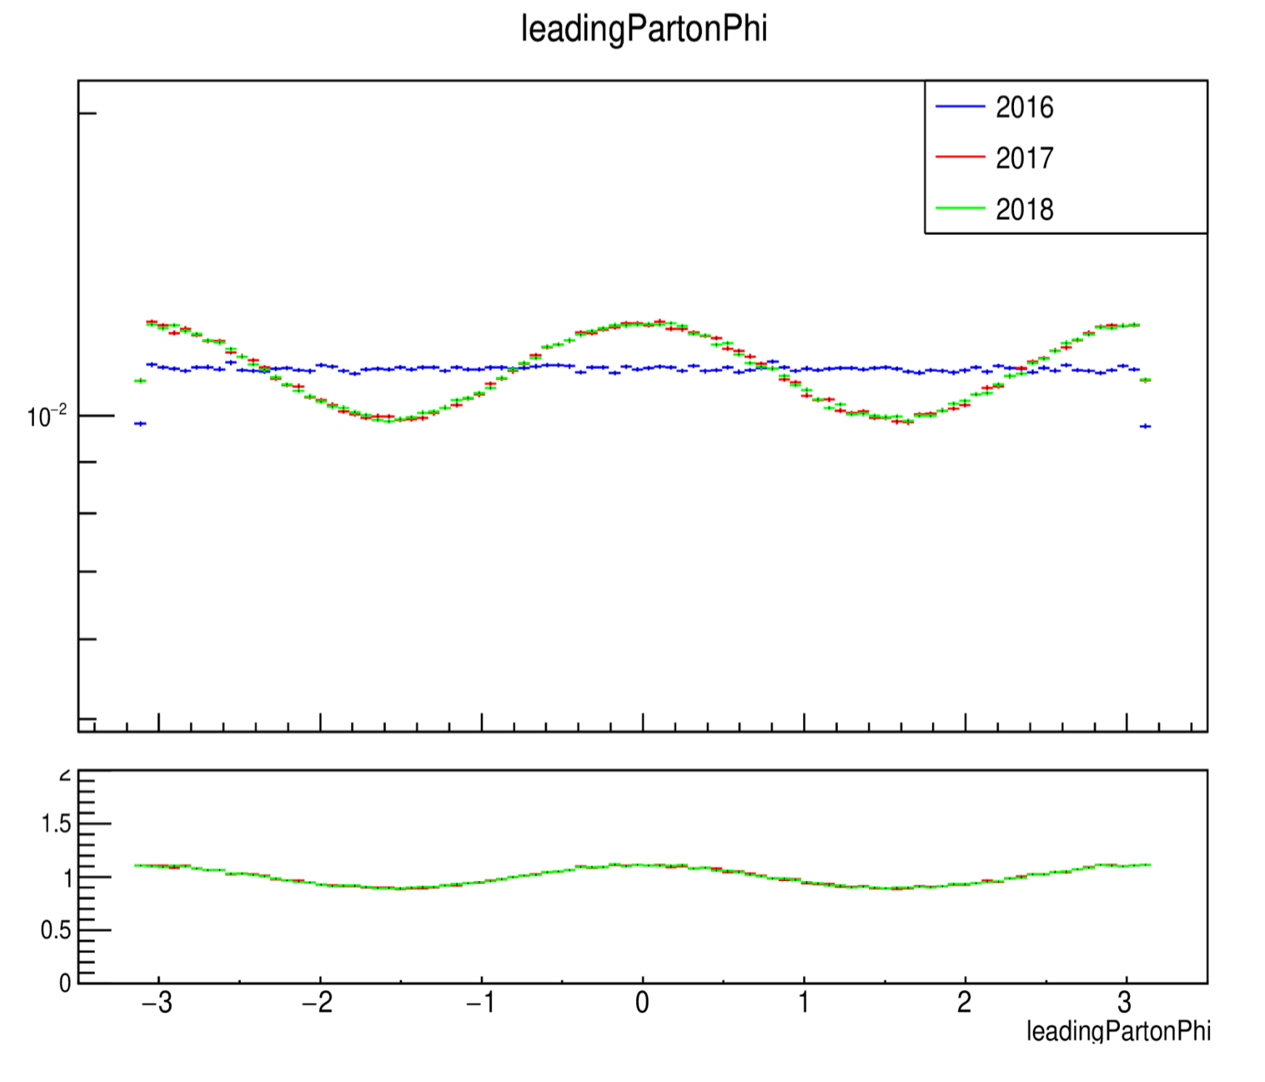
MC Closure tests ’16, ‘17 and ’18 (shape) for mtt files

Slide 6
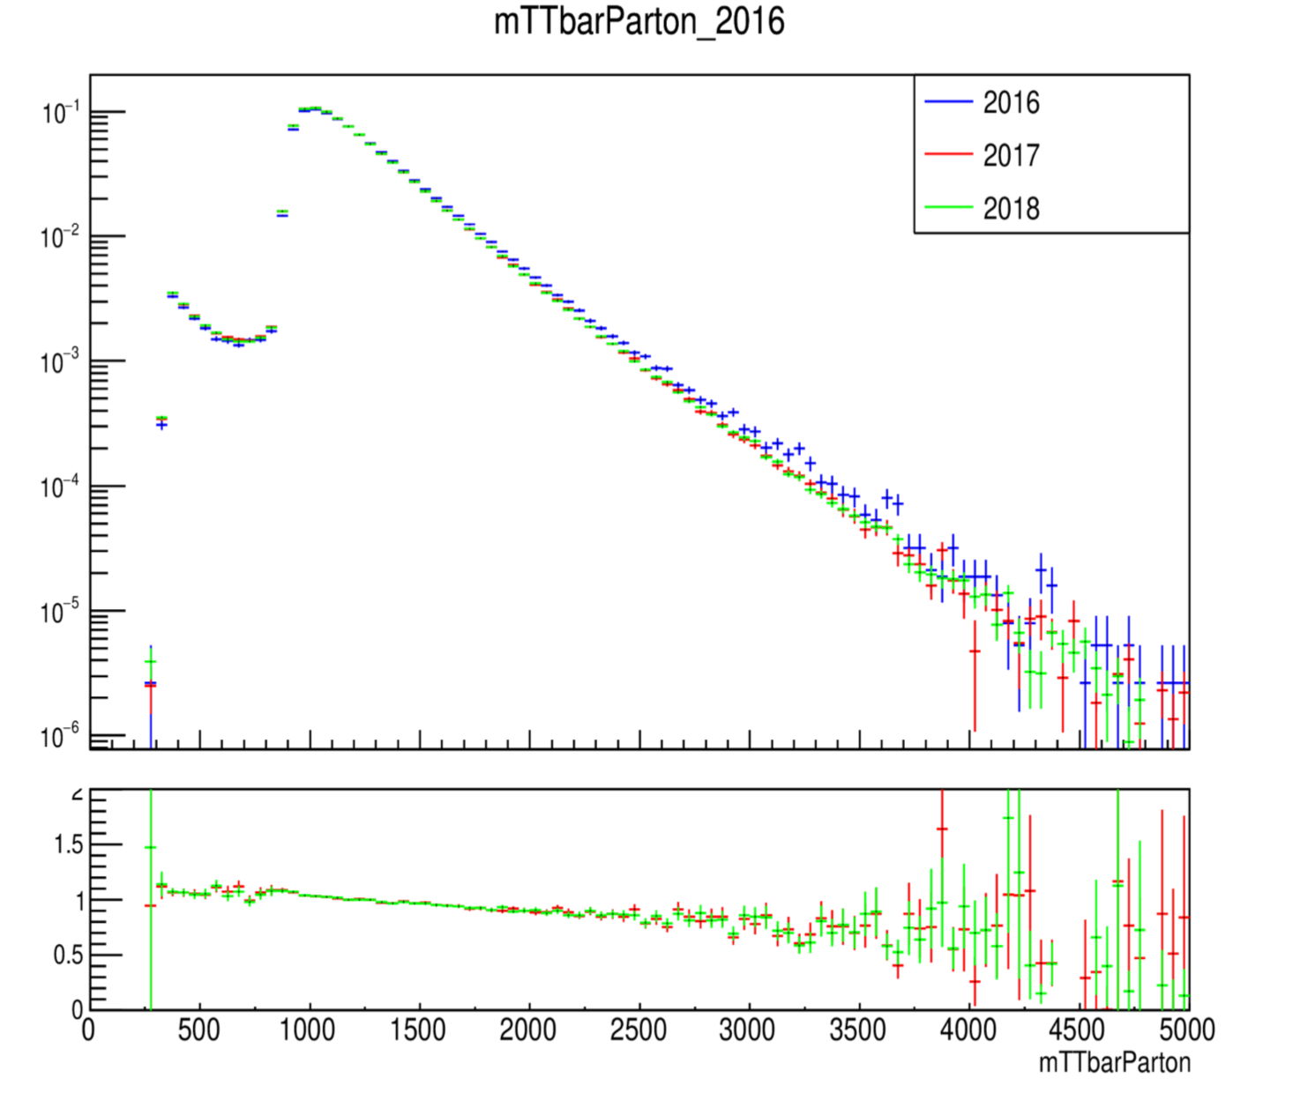
MC Closure tests ’16, ‘17 and ’18 (shape) nominal

Slide 7
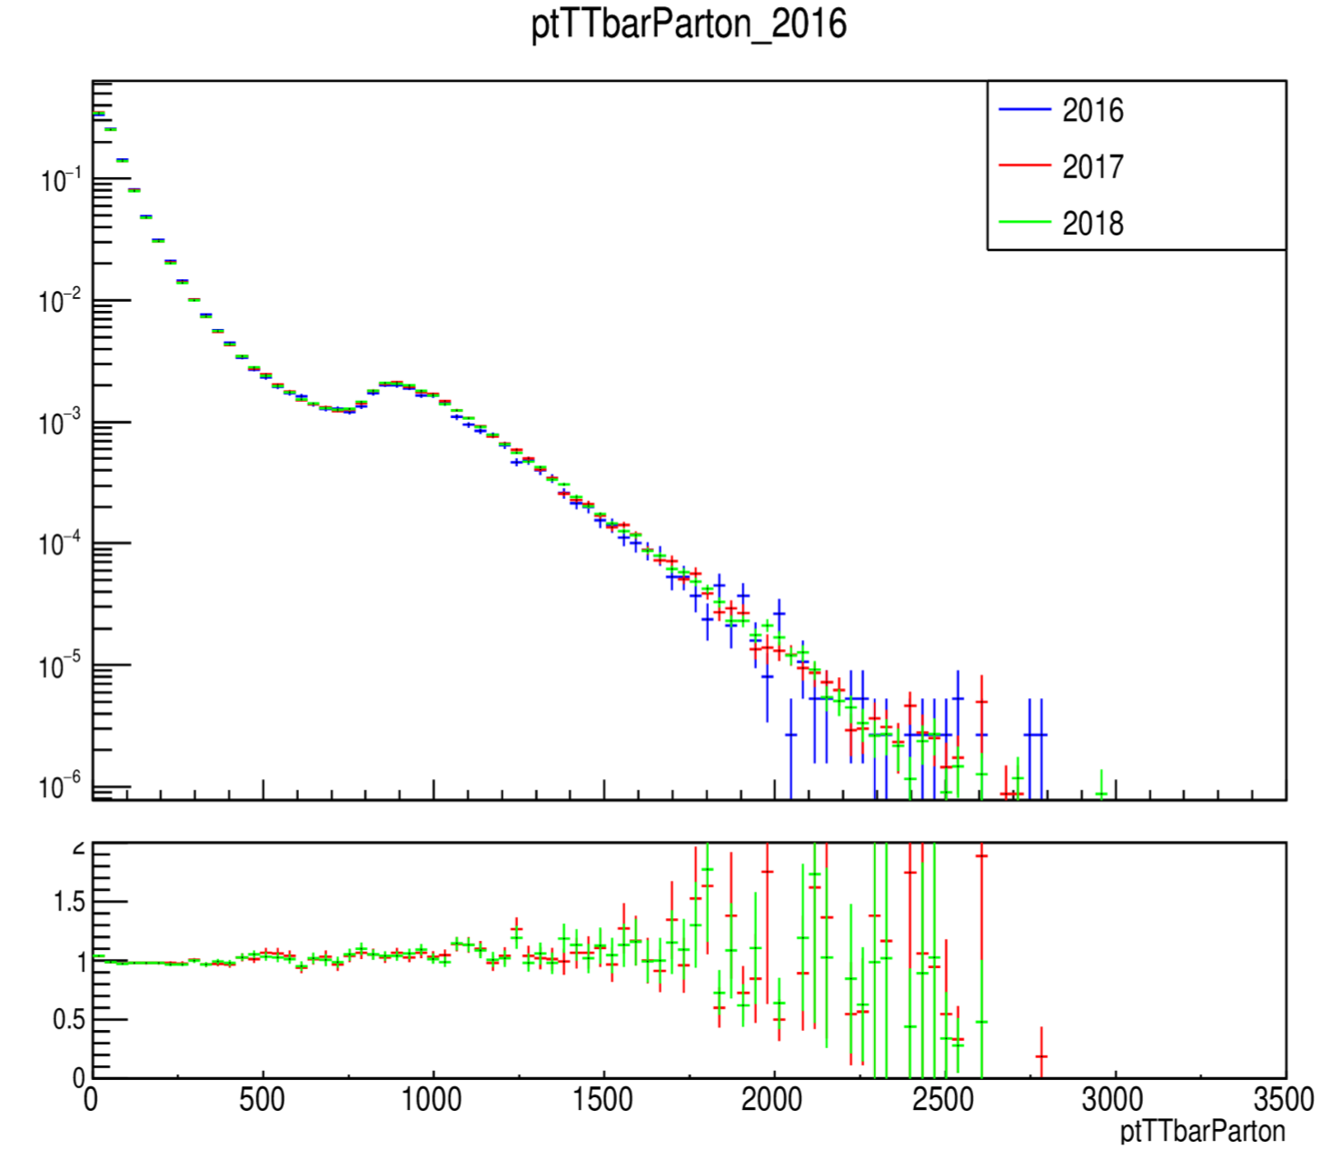
MC Closure tests ’16, ‘17 and ’18 (shape) nominal files

Slide 8
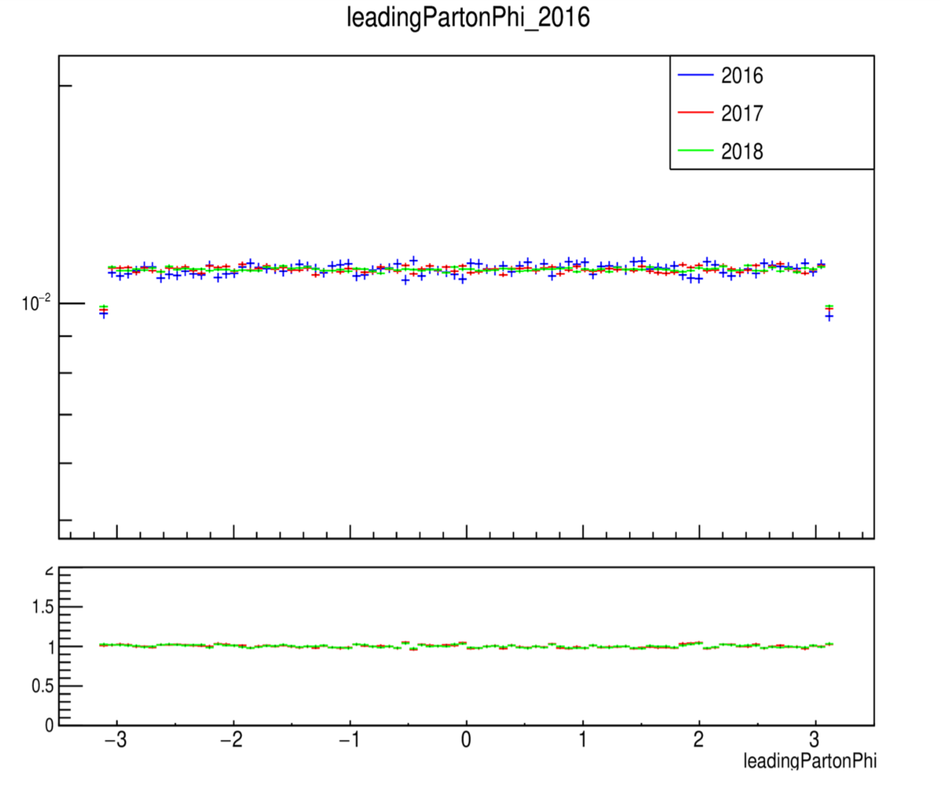
MC Closure tests ’16, ‘17 and ’18 (shape) nominal files

Slide 9
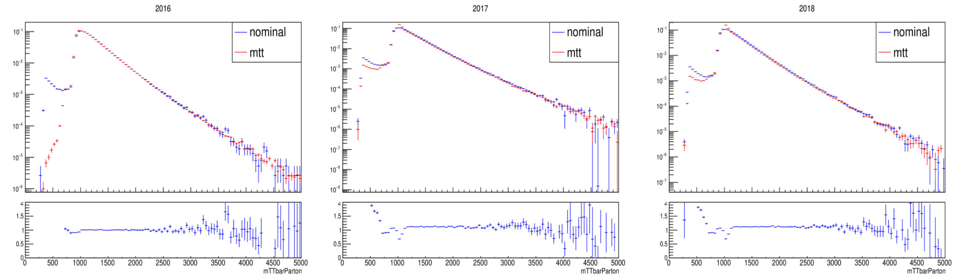
MC Closure Tests Mtt vs Nominal Parton

Slide 10
MC Closure Tests Mtt vs Nominal Parton

Slide 11
MC Closure Tests Mtt vs Nominal Parton

Slide 12
MC Closure Tests Nominal 2017 vs 2018 (shape) per slice

Slide 13
MC Closure Tests Nominal 2017 vs 2018 (shape) per slice

Slide 14
MC Closure Tests Nominal 2017 vs 2018 (shape) per slice

Slide 15
MC Closure Tests Nominal 2016 vs 2017 (shape) per slice

Slide 16
MC Closure Tests Nominal 2016 vs 2017 (shape) per slice

Slide 17
MC Closure Tests Nominal 2016 vs 2017 (shape) per slice

Slide 18
MC Closure Tests Nominal 2017 vs 2018 (shape) per slice Nominal

Slide 19
MC Closure Tests Nominal 2017 vs 2018 (shape) per slice Nominal

Slide 20
MC Closure Tests Nominal 2017 vs 2018 (shape) per slice Nominal

Slide 21
Efficiency from Nominal MC and High Mtt (corrected xsec) 2016

Slide 22
Efficiency from Nominal MC and High Mtt (1000-Inf File only) 2017

Slide 23
Efficiency from Nominal MC and High Mtt (1000-Inf File only) 2018

Slide 24
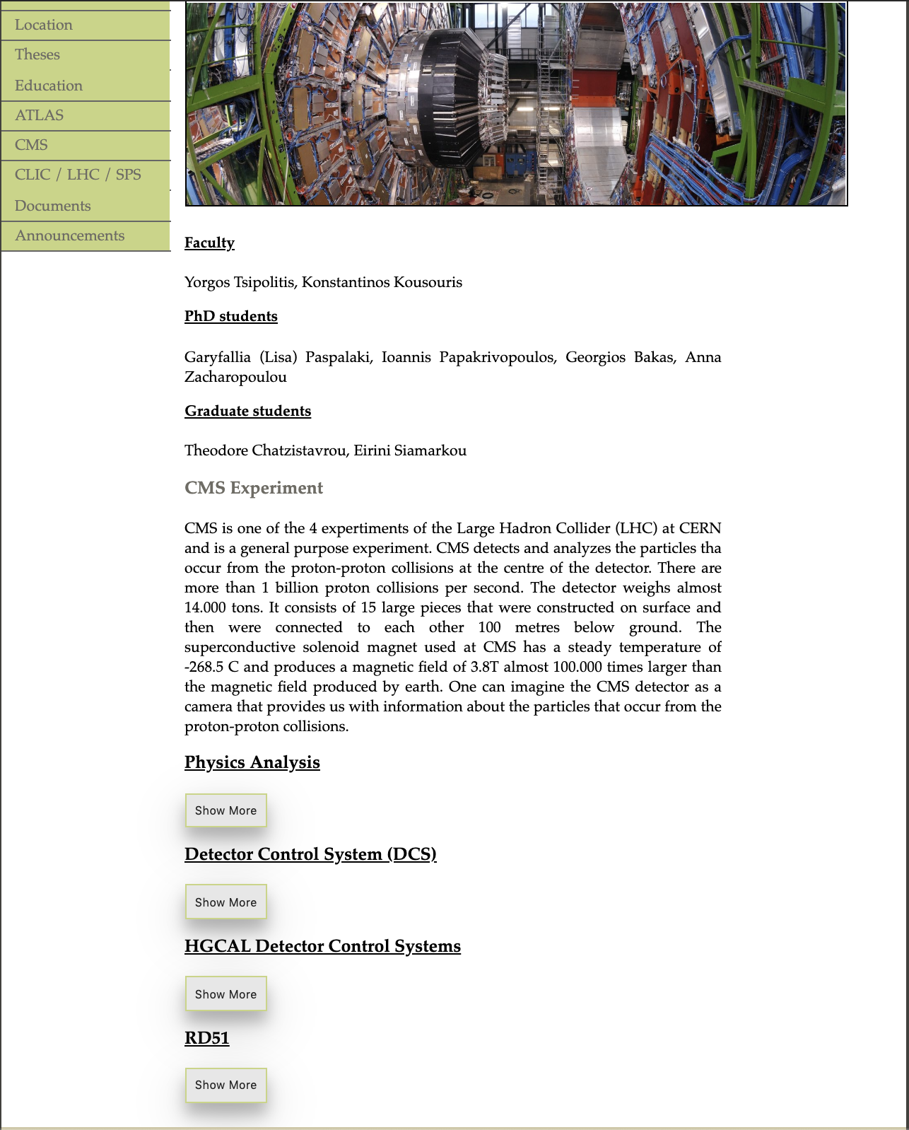
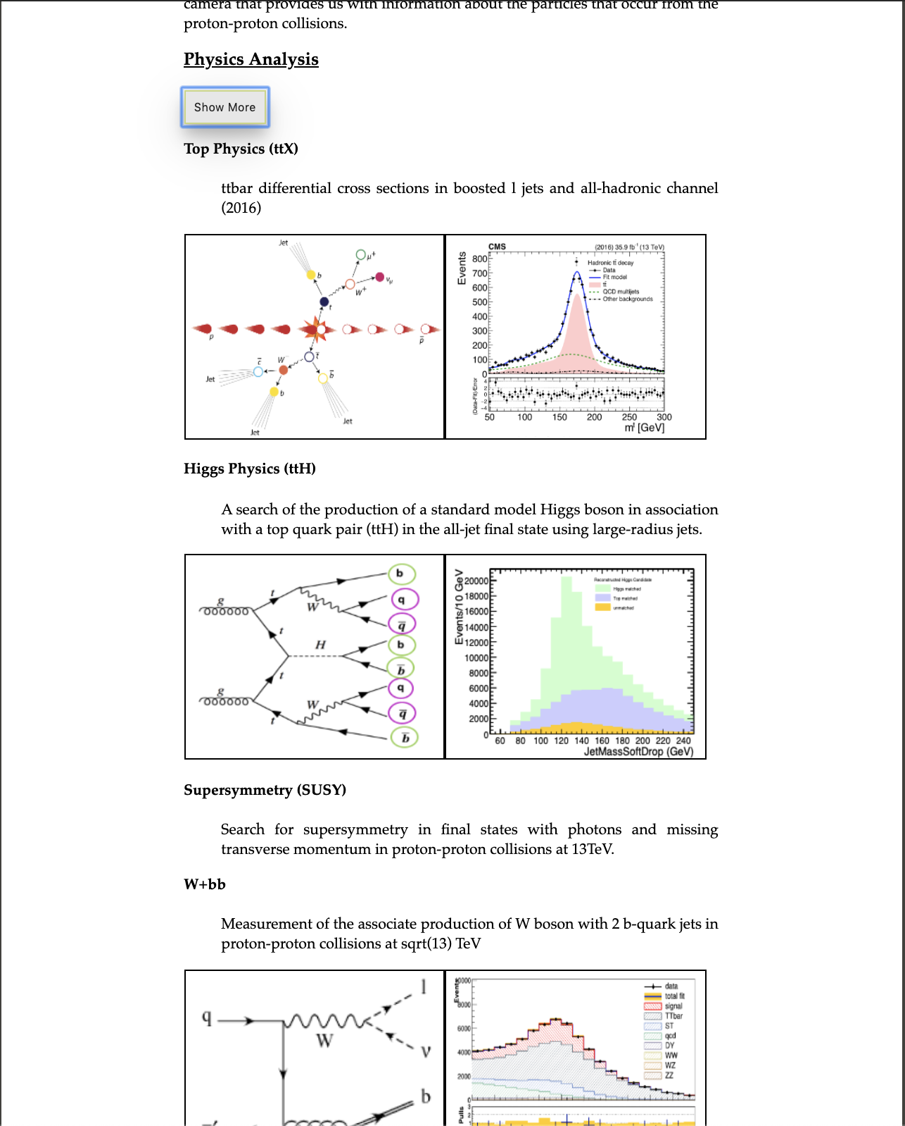
NTUA HEP Site

Slide 25
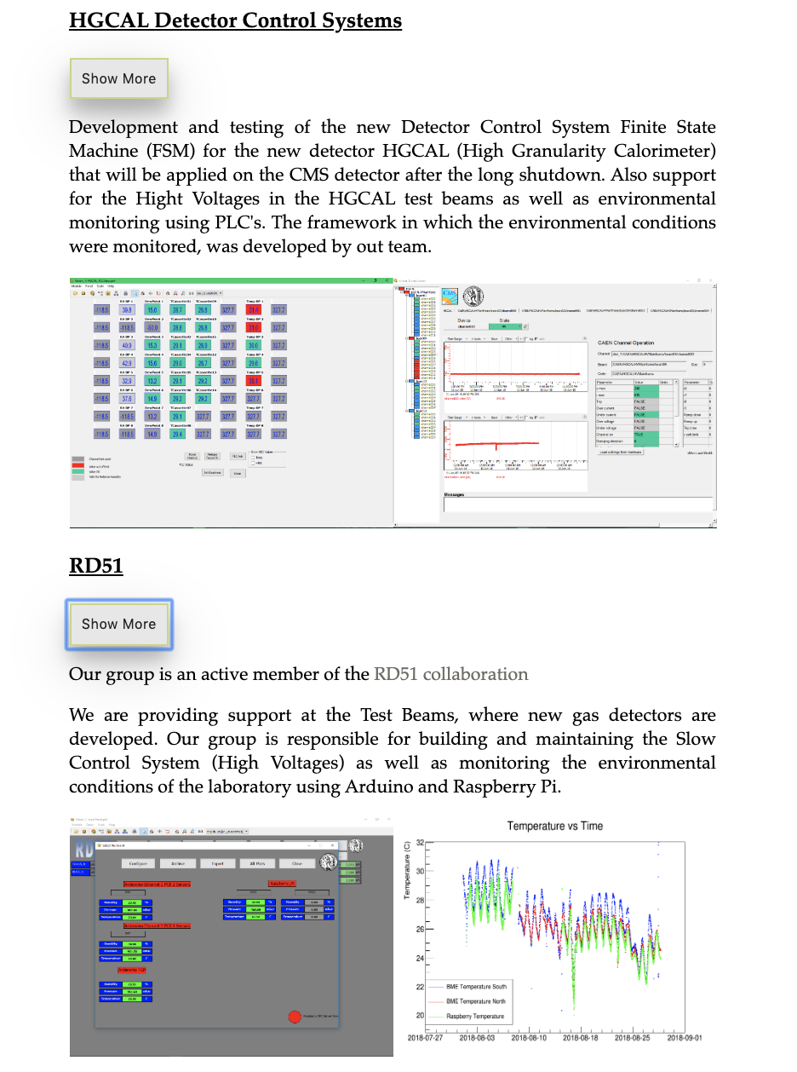
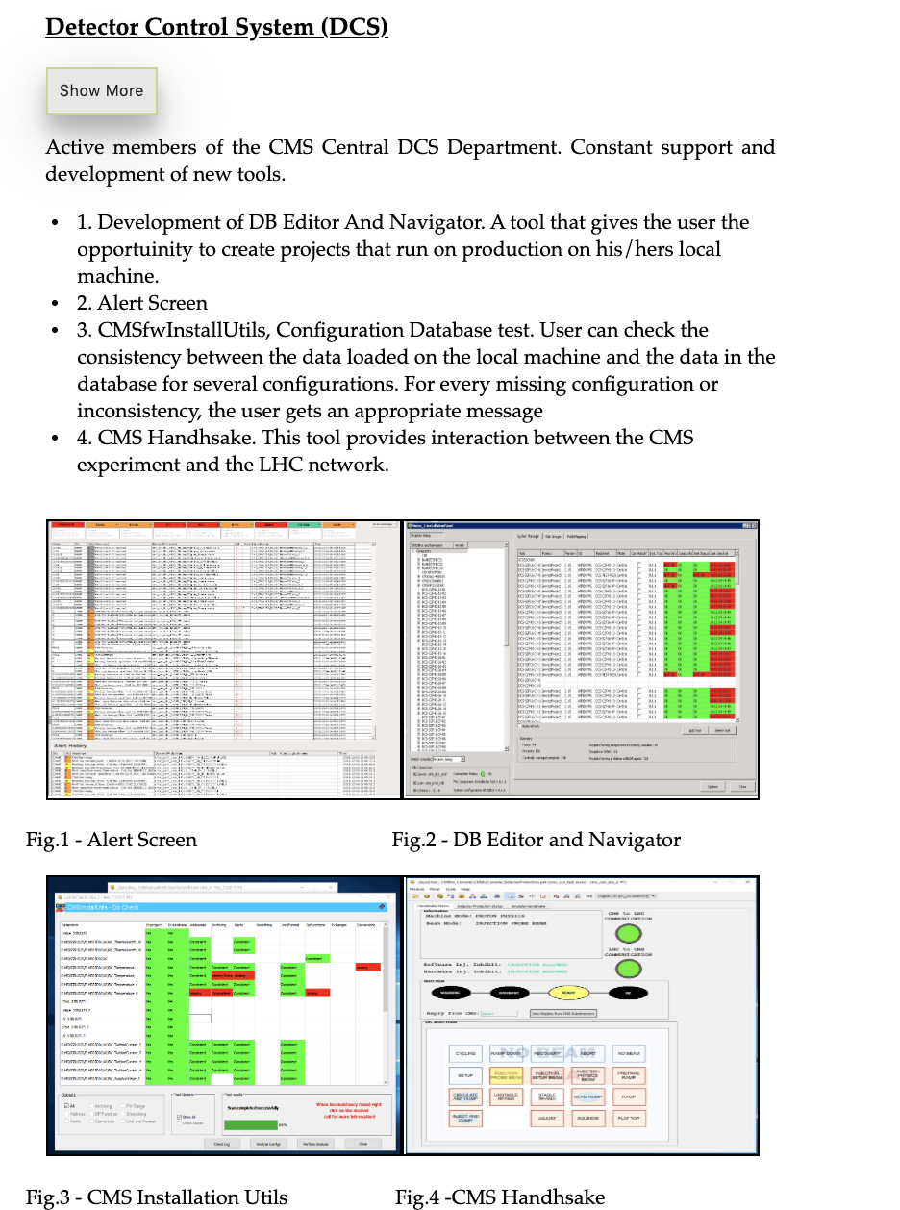
NTUA HEP Site

